Slide 1
West Midlands Cyber Ecosystem (WMCE)
Proposal for a West Midlands focused cyber interest group
A Pillar 1 driven response to the National Cyber Strategy
Hugo Russell, Project Manager, Cyber Quarter
19 January 2022

Slide 2
Outline
Context: 5 Pillars
Pillar 1: Cyber Ecosystem Objectives
Aim | Vision | Mission
Objectives
Situation
Resources
Tactics

Slide 3
National Cyber Strategy: 5 Pillars
Pillar 1: Strengthening the UK cyber ecosystem, investing in our people and skills and deepening the partnership between government, academia and industry
Pillar 2: Building a resilient and prosperous digital UK, reducing cyber risks so businesses can maximise the economic benefits of digital technology and citizens are more secure online and confident that their data is protected
Pillar 3: Taking the lead in the technologies vital to cyber power, building our industrial capability and developing frameworks to secure future technologies
Pillar 4: Advancing UK global leadership and influence for a more secure, prosperous and open international order, working with government and industry partners and sharing the expertise that underpins UK cyber power
Pillar 5: Detecting, disrupting and deterring our adversaries to enhance UK security in and through cyberspace, making more integrated, creative and routine use of the UK’s full spectrum of levers

Slide 4
Pillar 1: UK Cyber Ecosystem Objectives
Strengthening the UK cyber ecosystem, investing in our people and skills and deepening the partnership between government, academia and industry.
Objective 1:
Strengthen the structures, partnerships and networks necessary to support a whole-of-society approach to cyber
Objective 2:
Enhance and expand the nation’s cyber skills at every level, including through a world class and diverse cyber profession that inspires and equips future talent.
Objective 3:
Foster the growth of a sustainable, innovative and internationally competitive cyber and information security sector, delivering quality products and services, which meet the needs of government and the wider economy.
Strengthening the UK cyber ecosystem, investing in our people and skills and deepening the partnership between government, academia and industry.
Objective 1:
Strengthen the structures, partnerships and networks necessary to support a whole-of-society approach to cyber
Objective 2:
Enhance and expand the nation’s cyber skills at every level, including through a world class and diverse cyber profession that inspires and equips future talent.
Objective 3:
Foster the growth of a sustainable, innovative and internationally competitive cyber and information security sector, delivering quality products and services, which meet the needs of government and the wider economy.

Slide 5
Aim | Vision | Mission
Aim
Create a coherent alliance in response to the national cyber strategy that generates commercial and research value for the regions businesses and universities
Vision
A healthy cyber ecosystem that is both competitive and collaborative. One that shares best practices and leverages our diversity to become more resilient, innovative and attractive nationally and globally.
Mission
Coordinate events & activities so as to attract a larger national and global audience
Actively support academic and business Research & Innovation
Support Policy changes locally and influence nationally

Slide 6
WMCE Objectives
Governance
Chair rotates annually: Starting with Prof Pillai
Light touch, Transparent, Ecosystem [board] meeting six * annually - across the region
Mapping ecosystem
Networks: IASME + WMCRC + Science Parks + Tech centres + Industries
Influencers: People & Organisations
Activity schedule
Built around key cyber events (500+ people)
Leverage funded activities
Communications & Content
Leverage IAWM + amplify through our networks + Big 5 + conventional channels
Content library the promotes the region

Slide 7
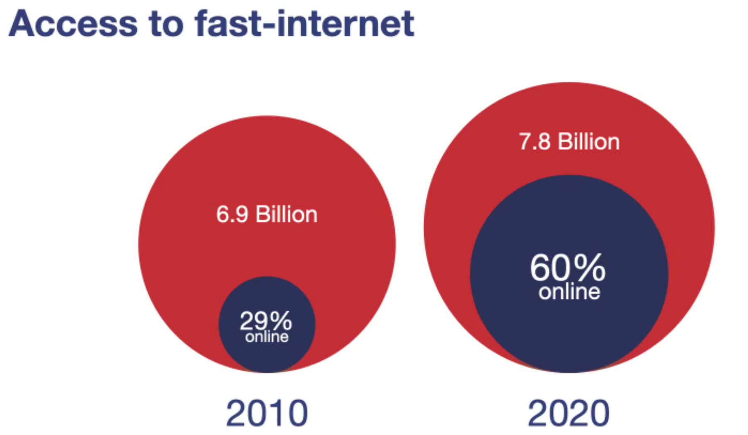
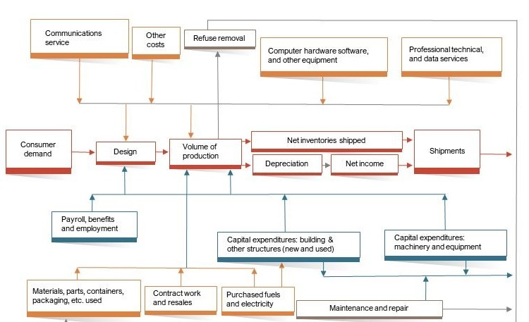
Situation:
Internet Connectivity
Global market
Academic position
Supply chain resilience

Slide 8
Resources
Innovation Alliance for the West Midlands
Whole of society approach (O1:66 + 67)
Established and Impartial
Midlands Cyber Cluster
The UK3C connection (O1:68)
Universities, Colleges, Apprenticeships
NCSC Certification + stakeholders (O2:71+74+75 )
Activities Events & Networks
Cyber Fringe Festival: Most diversity cyber event/expo (O2:73)
Birmingham Tech week + VentureFestWM + Cyber Fringe Festival (O3:72+79)
Regional Hubs
Midlands Cyber Cluster (O3:76+78)
Science Parks & Innovation Hubs (O3:72+79)

Slide 9
Next Actions
Website (Iain / Devon) IAWM
Brainstorm to improve this strategy
Capacity
Capability
Sustainability
Opportunities
External Threats & Internal Weaknesses
Working group:
Who (February & March)

Slide 10
References
National Cyber Strategy 2022
https://www.gov.uk/government/publications/national-cyber-strategy-2022/national-cyber-security-strategy-2022
A design-led approach to embracing an ecosystem strategy
https://www.mckinsey.com/business-functions/mckinsey-design/our-insights/a-design-led-approach-to-embracing-an-ecosystem-strategy
Ecosystem Mapping
https://www.boardofinnovation.com/tools/ecosystem-mapping/
https://www.strategytools.io/strategy-tools/ecosystem-map/

